Slide 1
Trees
INFO 3135
Trees
Binary
Heaps
Self Balancing

Slide 2
Trees
Linked lists provide greater flexibility than arrays, but they are linear structures and so it is difficult to use them to organize a hierarchical representation of objects.
Although stacks and queues reflect some hierarchy, they are limited to one dimension.
To overcome this limitation, we create a new data type called a tree that consists of nodes and arcs/edges.
Unlike natural trees, these trees are situated upside down with the root at the top and the leaves (terminal nodes) at the bottom.
The root is a node that has no parent; it can have only child nodes.
Leaves have no children, their children are empty structures.
A tree can be defined recursively as follows:
  An empty structure is an empty tree.
  If t1, . . . , tk are disjointed trees, then the structure whose root has as its children the roots of t1, . . . , tk is also a tree.
  Only structures generated by rules 1 and 2 are trees.

Slide 3
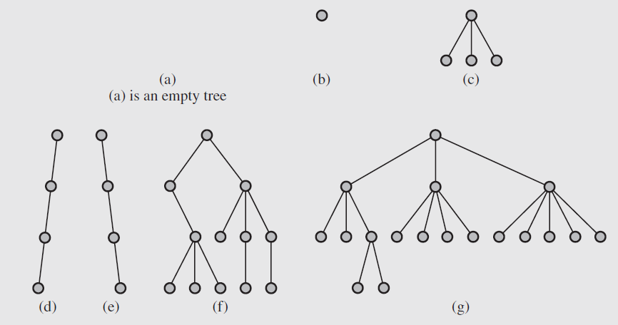
Trees

Slide 4
Not Trees
Cycle A→A
Disjoint: A,B not connected to C,D,E
Cycle A →B →C →D →A
B has 2 parents

Slide 5
Trees
Examples of tree structures.
  File system on a computer
  Company management structure – org chart
  Syntax tree used in compilers
  Router algorithms
  Company department structure
Each node has to be reachable from the root through a unique sequence of edges, called a path.

Slide 6
Tree semantics/terms
The number of edges in a path is called the length of the path.
The level of a node is the length of the path from the root to the node plus 1, which is the number of nodes in the path.
The height of a non-empty tree is the maximum level of a node in the tree.
The empty tree is a legitimate tree of height 0 (by definition), and a single node is a tree of height 1. This is the only case where a node is both the root and a leaf.
The level of a node must be between 1 (the level of the root) and the height of the tree, which in the extreme case is the level of the only leaf in a degenerate tree resembling a linked list.

Slide 7
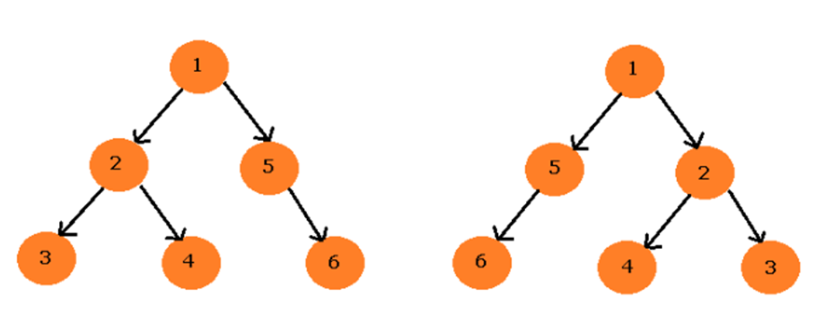
Tree categories
Unordered :
  A rooted tree (or unordered tree) is a node (called the root) connected to a multiset of rooted trees.
  when nodes are not in a particular order (e.g. a “scene graph”, “way points”, etc.)
  hash tables, disjoint sets and graphs – where access is direct
Ordered :
  An ordered tree is an oriented tree in which the children of a node are somehow "ordered.“ or “sorted”
  An ordered tree contains nodes (elements) which can be ordered according to a specific criteria.

Slide 8
Tree Types
Binary Tree :
  An ordered tree in which every node has at most two children
  Every node has at most two children.
  Each child node is labeled as being either a left child or a right child.
  A left child precedes a right child in the ordering of children of a node.
Binary search tree - BST :
  the data of all the nodes in the left sub-tree of the root node should be <= the data of the root.
  the data of all the nodes in the right subtree of the root node should be > the data of the root.
AVL tree - height balanced binary tree :
  a self-balancing Binary Search Tree (BST) where the difference between heights of left and right subtrees cannot be more than one for all nodes
  Can be expensive to balance (compared to a red-black tree)
  Named after these guys: Georgy Adelson-Velsky and Evgenii Landis

Slide 9
Tree Types
Red-Black tree (what std::map usually is):
  a binary search tree with one extra attribute for each node: the “colour”, which is either red or black. Intended for search speed, with frequent inserts/deletes.
  Every node is either “red” or “black”.
  Root note is “black”. Every leaf is “black”.
  If a node is “red”, then both its children are “black”.
    After an insertion/deletion, if this isn’t the case, a “rotation” occurs (see next slide)
  Result: the path from a node to a descendant leaf has same number of black nodes.
N-ary tree :
  a rooted tree in which each node has no more than N children
Heap :
  balanced binary tree data structure where the root-node key is compared with its children and arranged accordingly

Slide 10
Rotation, re-balancing
The definition of a tree does not impose any condition on the number of children of a given node. Each node can have 0 to ∞ (but 1 parent).
“Rebalancing” is where the nodes are re-arranged to try to “balance” a tree (AVL or red-black)
“Rotating” is where the root of a tree/branch is changed (like below), which changes the “depth” and/or “balance” of the tree:
A
B
Becomes…
D
A
B
C
D
H
F
G
C
F
G
H
i.e. it’s like A & B are “rotated” (yes, it’s sort of a silly description)

Slide 11
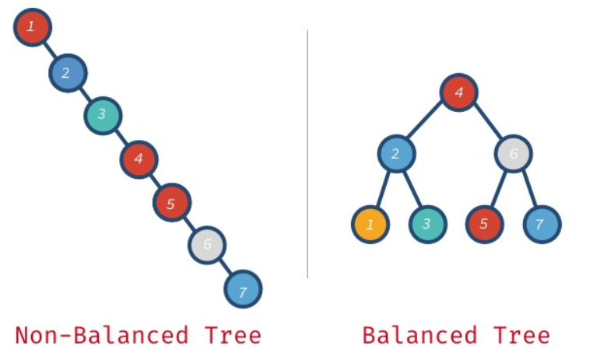
Balanced?

Slide 12
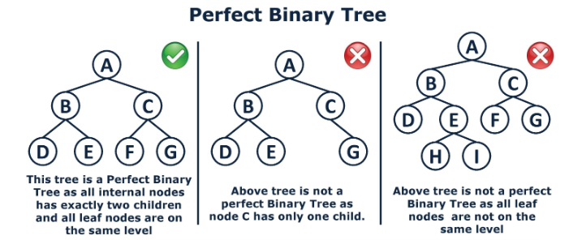
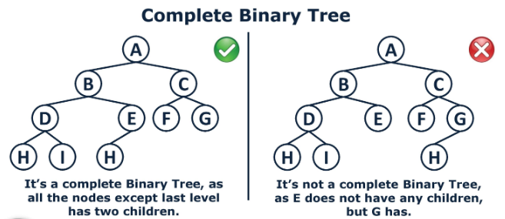
Binary Tree

Slide 13
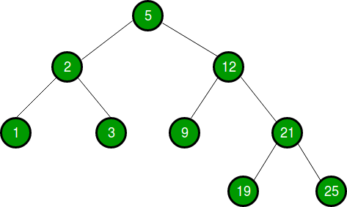
Binary Search Tree
The left subtree of a node contains only nodes with keys lesser than the node’s key.
The right subtree of a node contains only nodes with keys greater than the node’s key.
The left and right subtree each must also be a binary search tree.
Items are inserted so they stay in order.

Slide 14
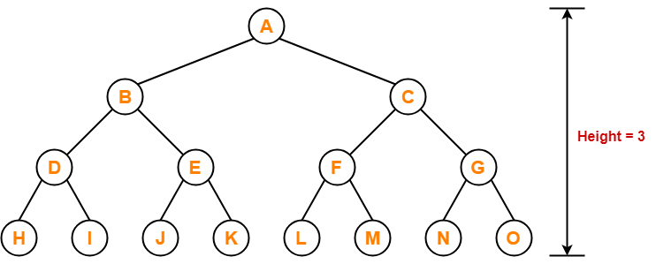
AVL – Height balanced tree
Height-Balance Property: For every internal node v of T, the heights of the children of v differ by at most 1.
Any binary search tree T that satisfies the height-balance property is said to be an AVL tree

Slide 15
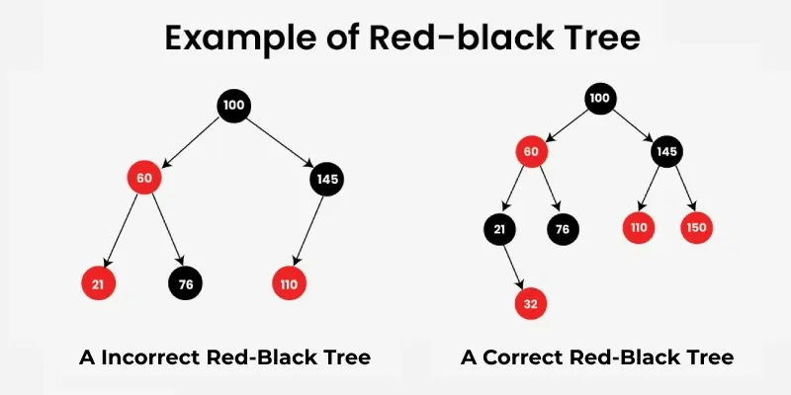
Red Black Tree
Each node is either red or black.
The root is black. All leaves are black.
If a node is red, then both its children are black.
Every path from a given node to any of its descendant nodes contains the same number of black nodes.
Since rebalancing (or rotation) is expensive…
On an insert, the patterns of colours (comparing the node to the parent and children) are checked indicating the tree might be unbalanced.
If the pattern is wrong:
  Attempt to “recolour” the nodes
  If that doesn’t work, a full balance (rotations) need to happen
The goal isn’t actually for a perfect balance, but for speed of insert, delete, and search.

Slide 16
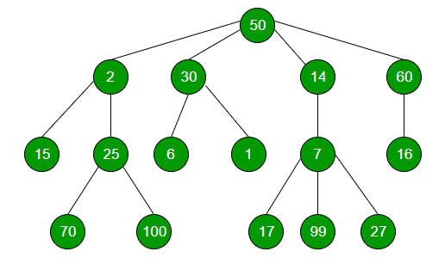
N-ary Tree
Nodes may have n number of children
So not a “binary” tree:
  Scene graph
  Animation skeleton
  Path/map finding (waypoints)
  Hierarchy/relationships
  General rules/policies

Slide 17
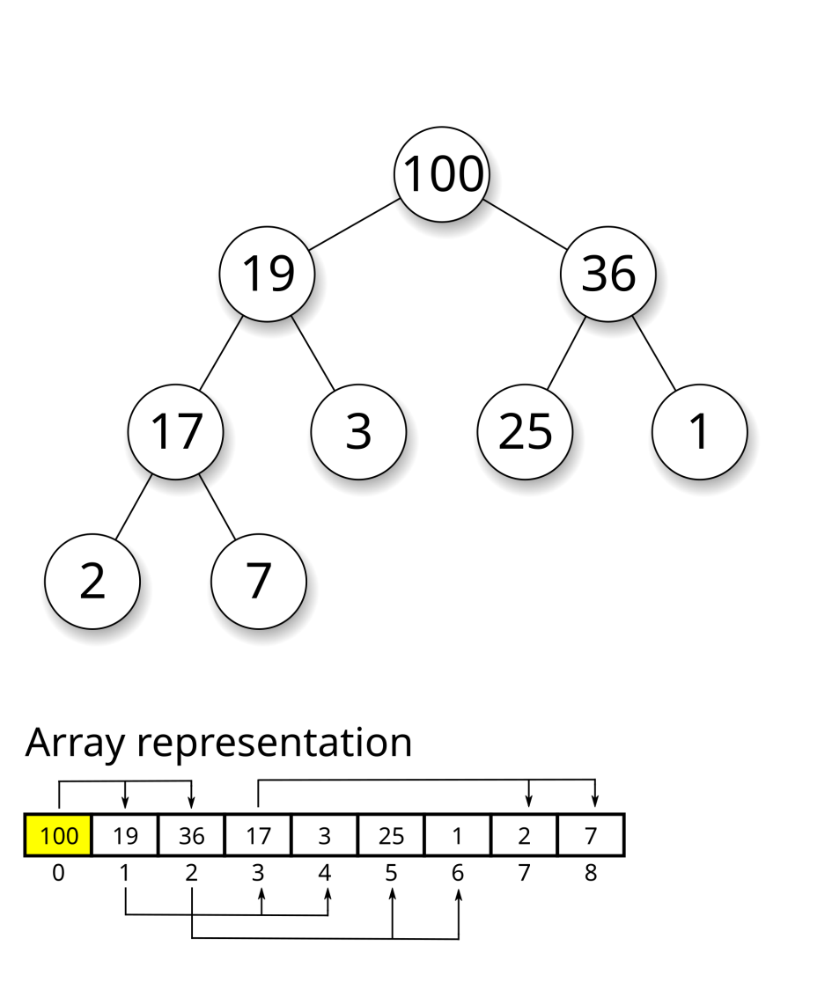
Heap Tree
A complete binary tree which satisfies one of the two (2) “heap ordering” properties:
  the min-heap property: the value of each node is greater than or equal to the value of its parent, with the minimum-value element at the root.
  the max-heap property: the value of each node is less than or equal to the value
  of its parent, with the maximum-value element at the root.
Notice on the right the values go from greatest to least
Often stored directly in an array where the parent-child
relationship is implied (i.e. the location of the “next” node
is fixed and calculated from the current node location).
Insertion and deletion can cause regeneration of the heap.

Slide 18
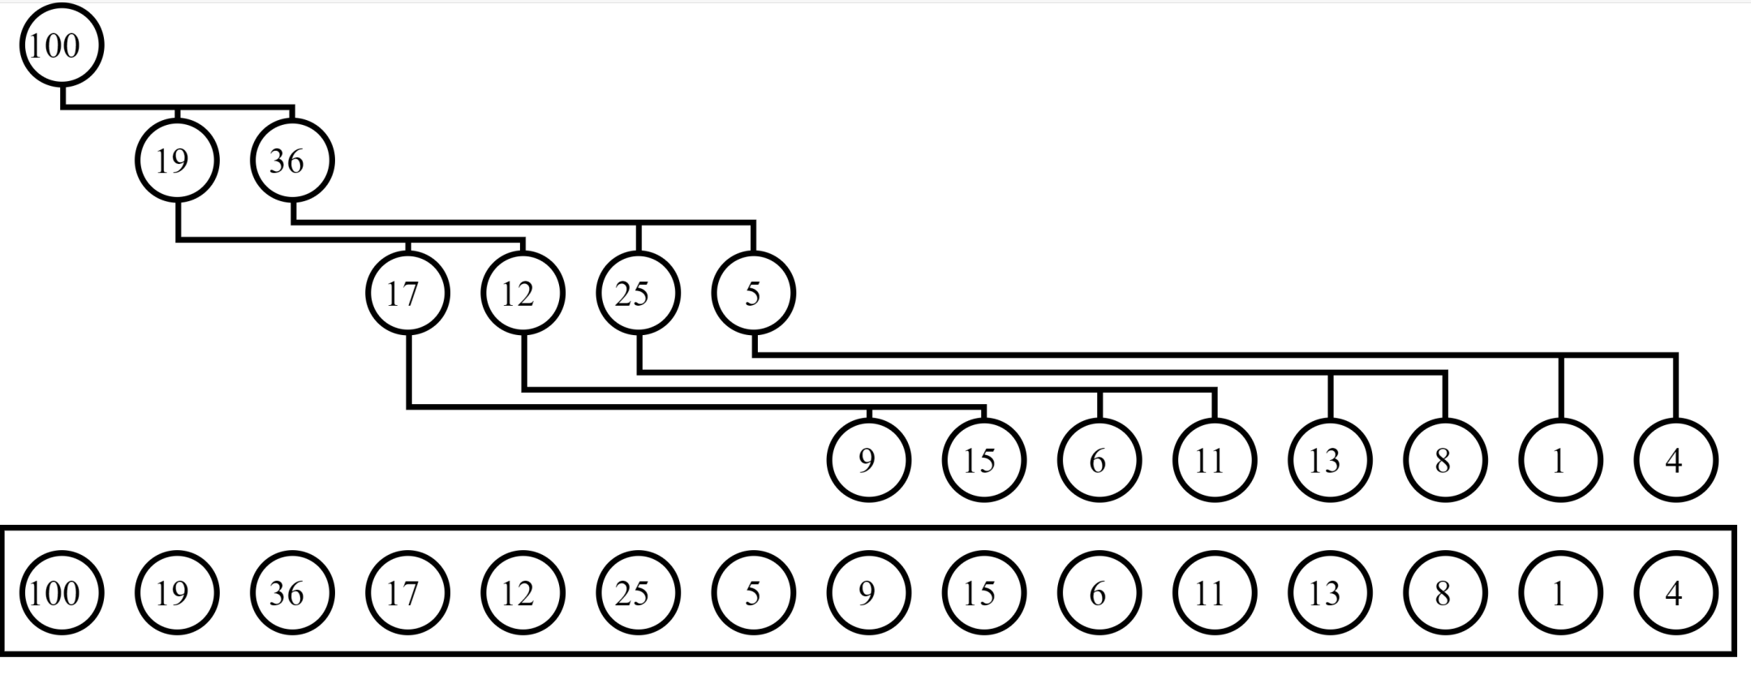
Heap Tree
Here’s an image from Wikipedia, showing how a heap could be stored as a tree, and also as a 1D array:
The location of the children are at 2n and 2n+1:
“100” is at =index 1
“19” is at 2(1)=index 2; “36” is at 2(1)+1=index 3
“11” is at 2(3)+4=index 10; “13” is at 2(3)+5=index 11

Slide 19
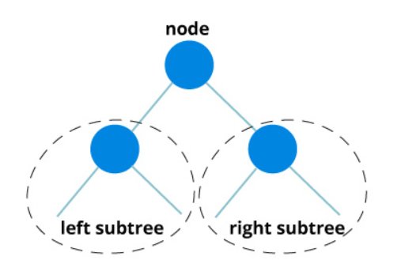
Traversing Trees
Traversing a tree means visiting every node in the tree.
Hierarchical data structures like trees can be traversed in different ways.
Every tree is a combination of
  A node carrying data
  Two subtrees

Slide 20
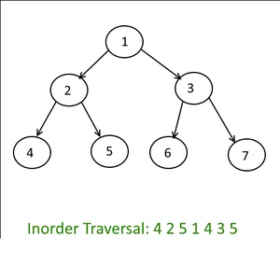
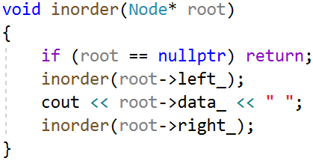
In-order traversal
Visit all the nodes in the left subtree (recursively call inorder(root->left) )
Visit the root node
Visit all the nodes in the right subtree (recursively call inorder(root->right) )

Slide 21
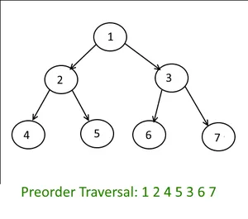
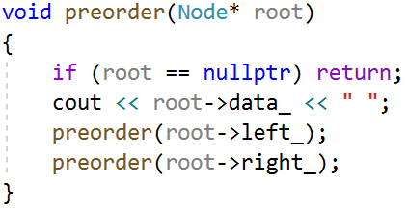
Pre-order traversal
Visit the root node
Visit all the nodes in the left subtree (recursively call inorder(root->left) )
Visit all the nodes in the right subtree (recursively call inorder(root->right) )

Slide 22
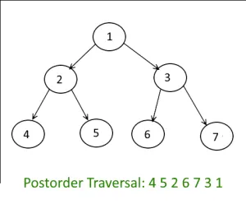
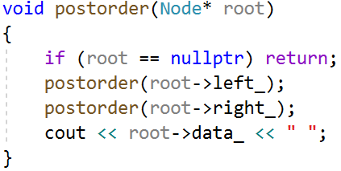
Postorder traversal
visit all the nodes in the left subtree (recursively call inorder(root->left) )
visit all the nodes in the right subtree (recursively call inorder(root->right) )
visit the root node

Slide 23
Insert, Delete, Reorder, Rebalance…
These operations are can be more sophisticated than linear structures
We will visit some of these:
  Enumerating all the items
  Enumerating a section of a tree
  Searching for an item
  Adding a new item at a certain position in the tree
  Deleting an item
  Pruning: Removing a whole section of a tree
  Grafting: Adding a whole section to a tree
  Finding the root for any node

Slide 24
Terms Review
Root: the topmost node of the tree
Edge: the link between 2 nodes
Child: a node that has a parent node
Parent: a node that has an edge to a child node
Leaf: a node that does not have a child node in the tree
Height: The height of a tree is the length of the longest path to a leaf.
Depth: The depth of a node is the length of the path to its root.

